Slide 1
OUR TEAM
Huyền
Khoa
Nga

Slide 2
01
STORY HELLOWEEN

Slide 3
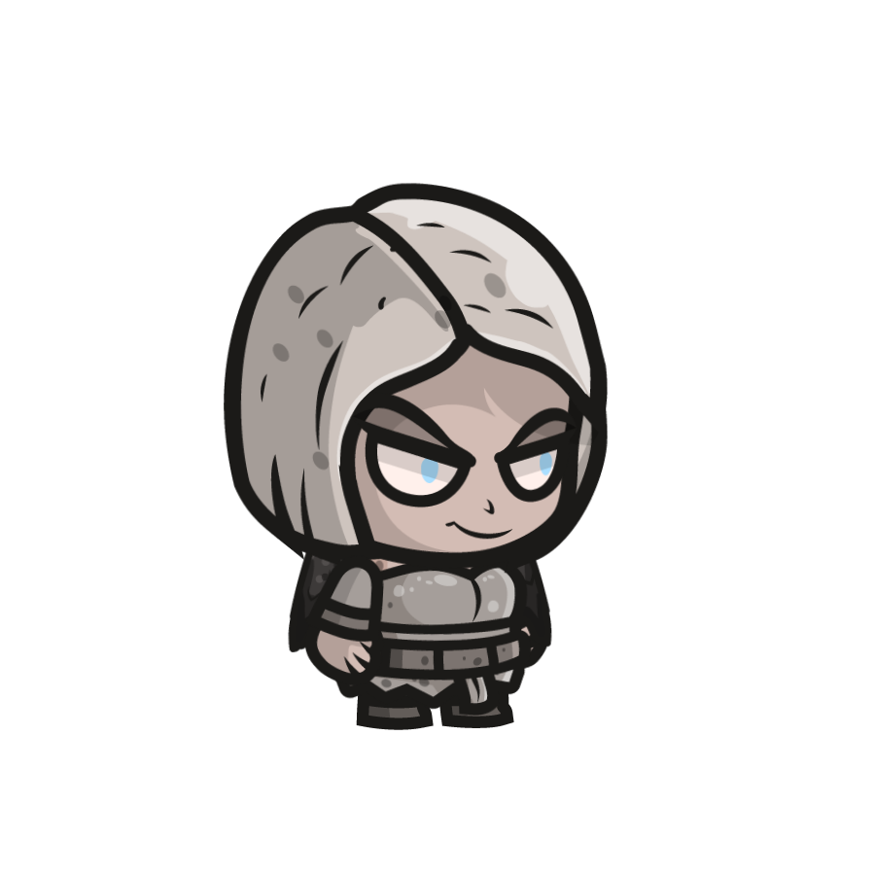
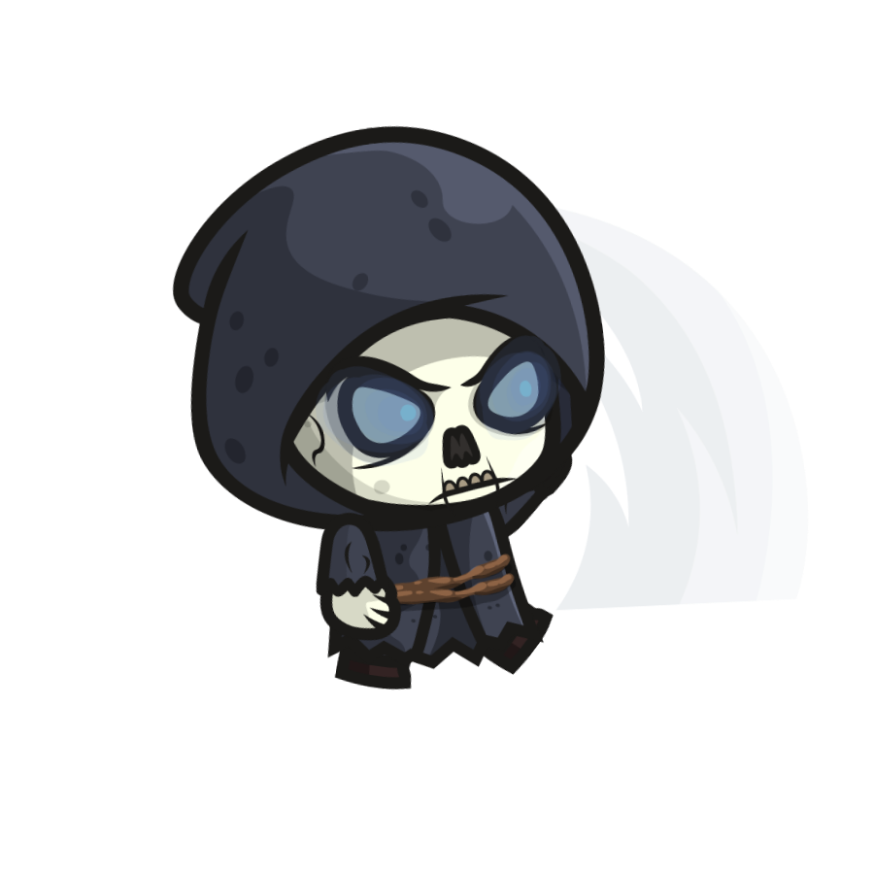
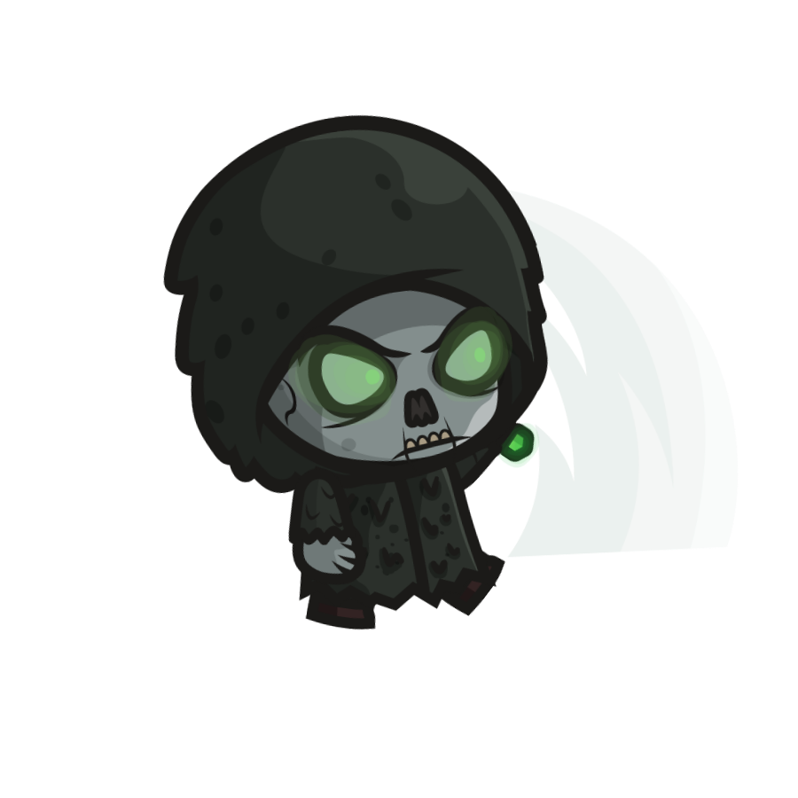
Once upon a time…

Slide 4
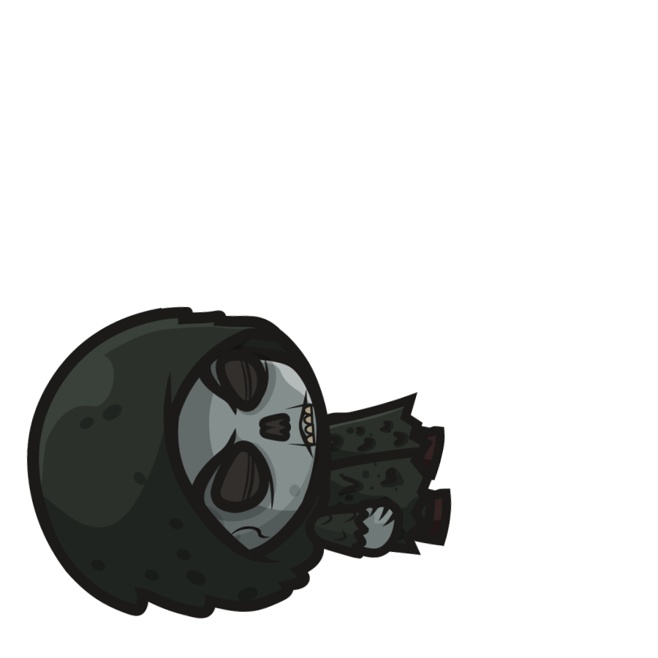
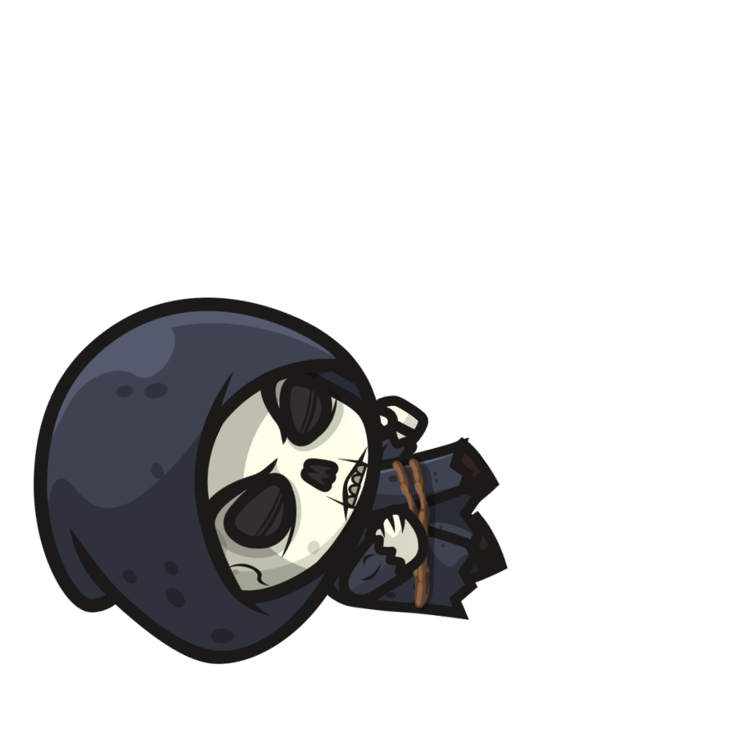
But in a war

Slide 5
Luckily, they still exitst

Slide 6
They meet the witch

Slide 7
Hello Ween
Starting now

Slide 8
GUIDE
Player1
Player2
- Move: A S D W
- Shoot: Spcace
- Move : Arrows key
- Shoot: Enter

Slide 9
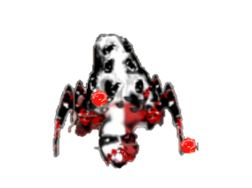


OBJECT
Coin
Energy
Monster
- Item map 1.
- Appears random, no appears again
- Number: 100
- Item round 2.
- Appears random, can appears again.
- Number: 10
- Item round 3.
- Direction bullets chasing player
- Number:1

Slide 10
02
ROUNDS GAME
The rounds game are scored according to
each victory. Player win can become human
again and live happy with the princess.
Player lose will come to the hell.

Slide 11
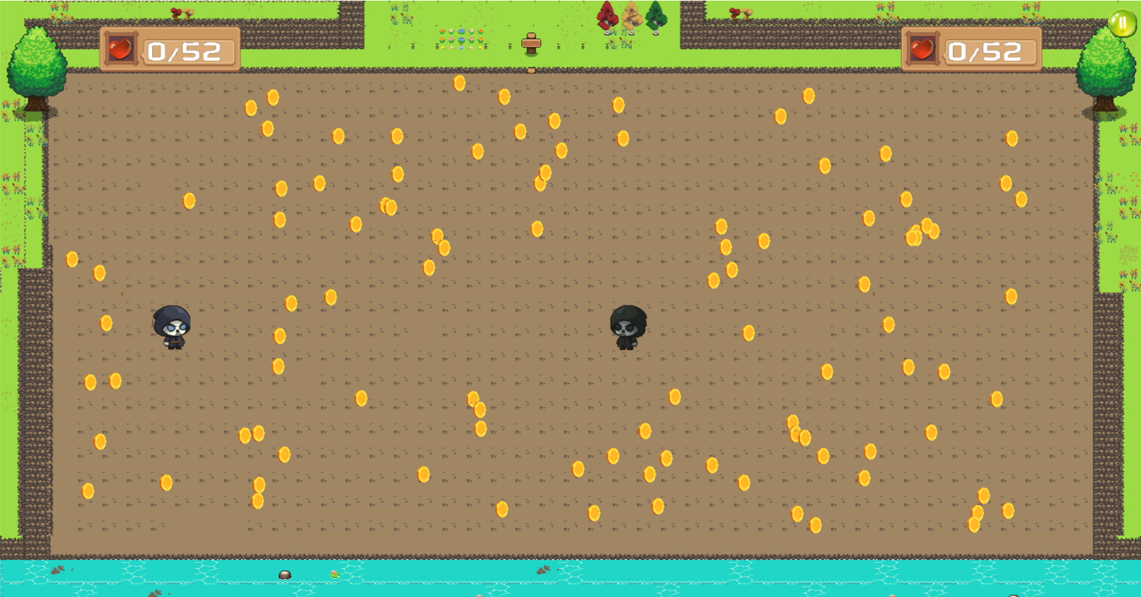
ROUND1 : PACMAN
- Collect full target coin to win.
- Can revive but lost heart.
- Shoot to kill other

Slide 12
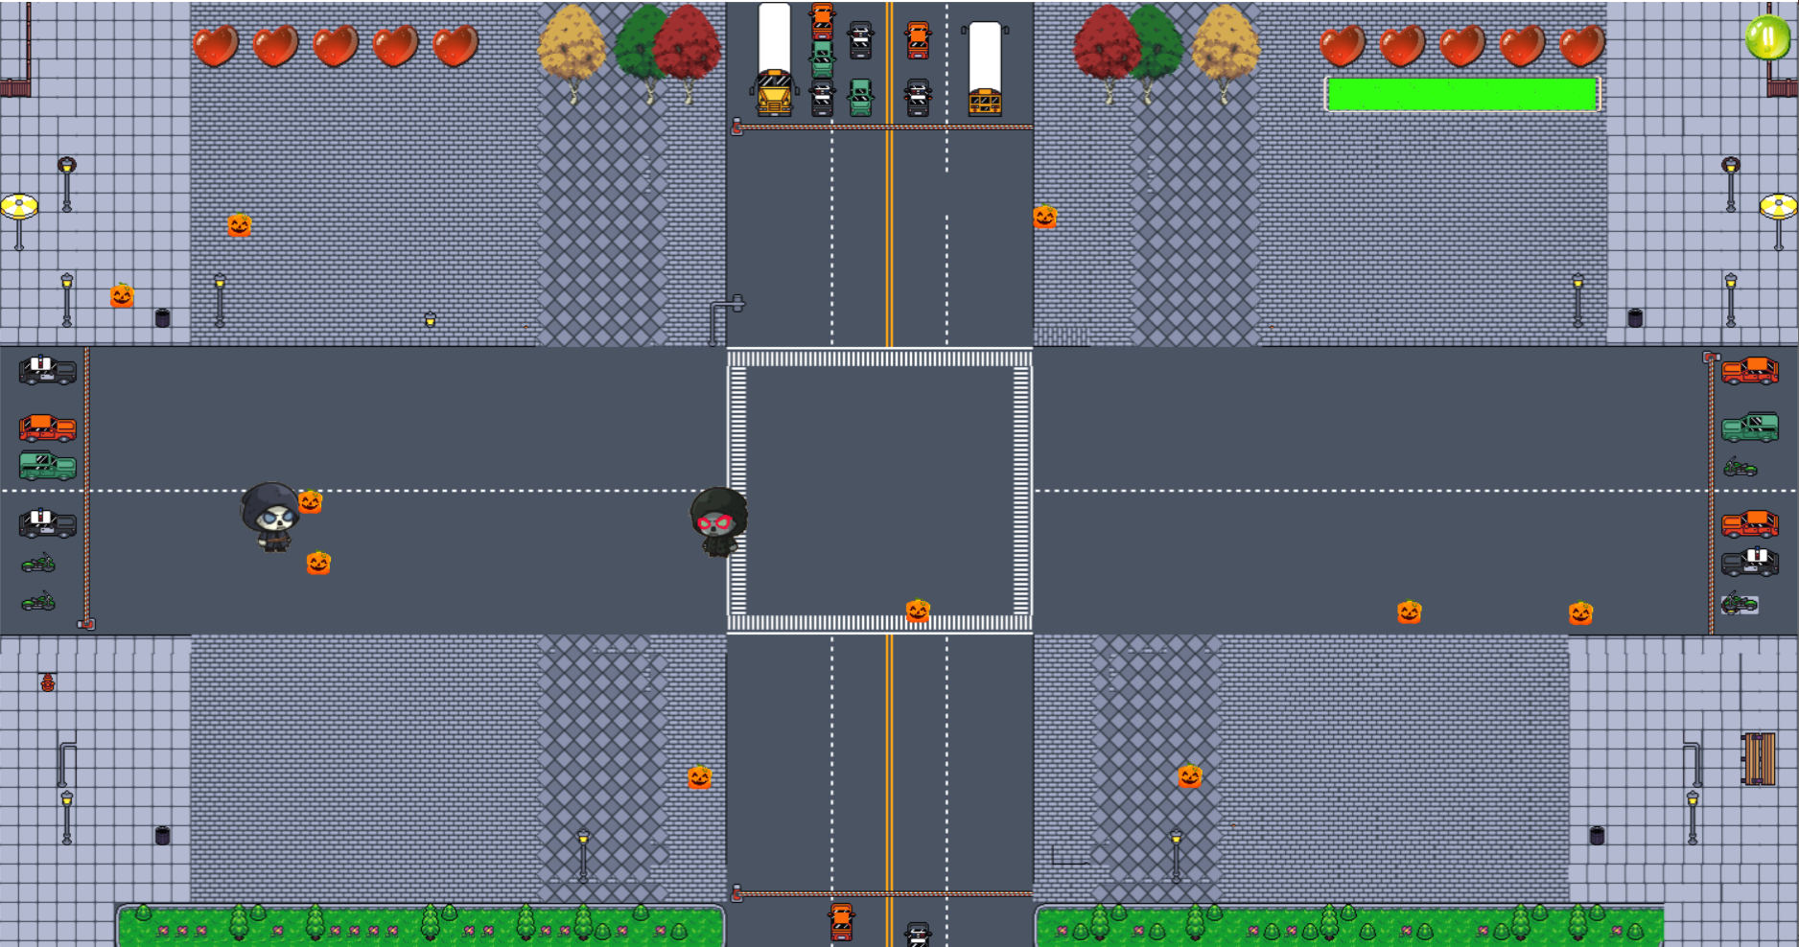
ROUND2 : SURVIVAL
- Collect 6 energy to full mana.
- Mana full can shoot 6 bullets.
- 1 bullet can lost 1 heart.
- Lost all heart = lose.

Slide 13
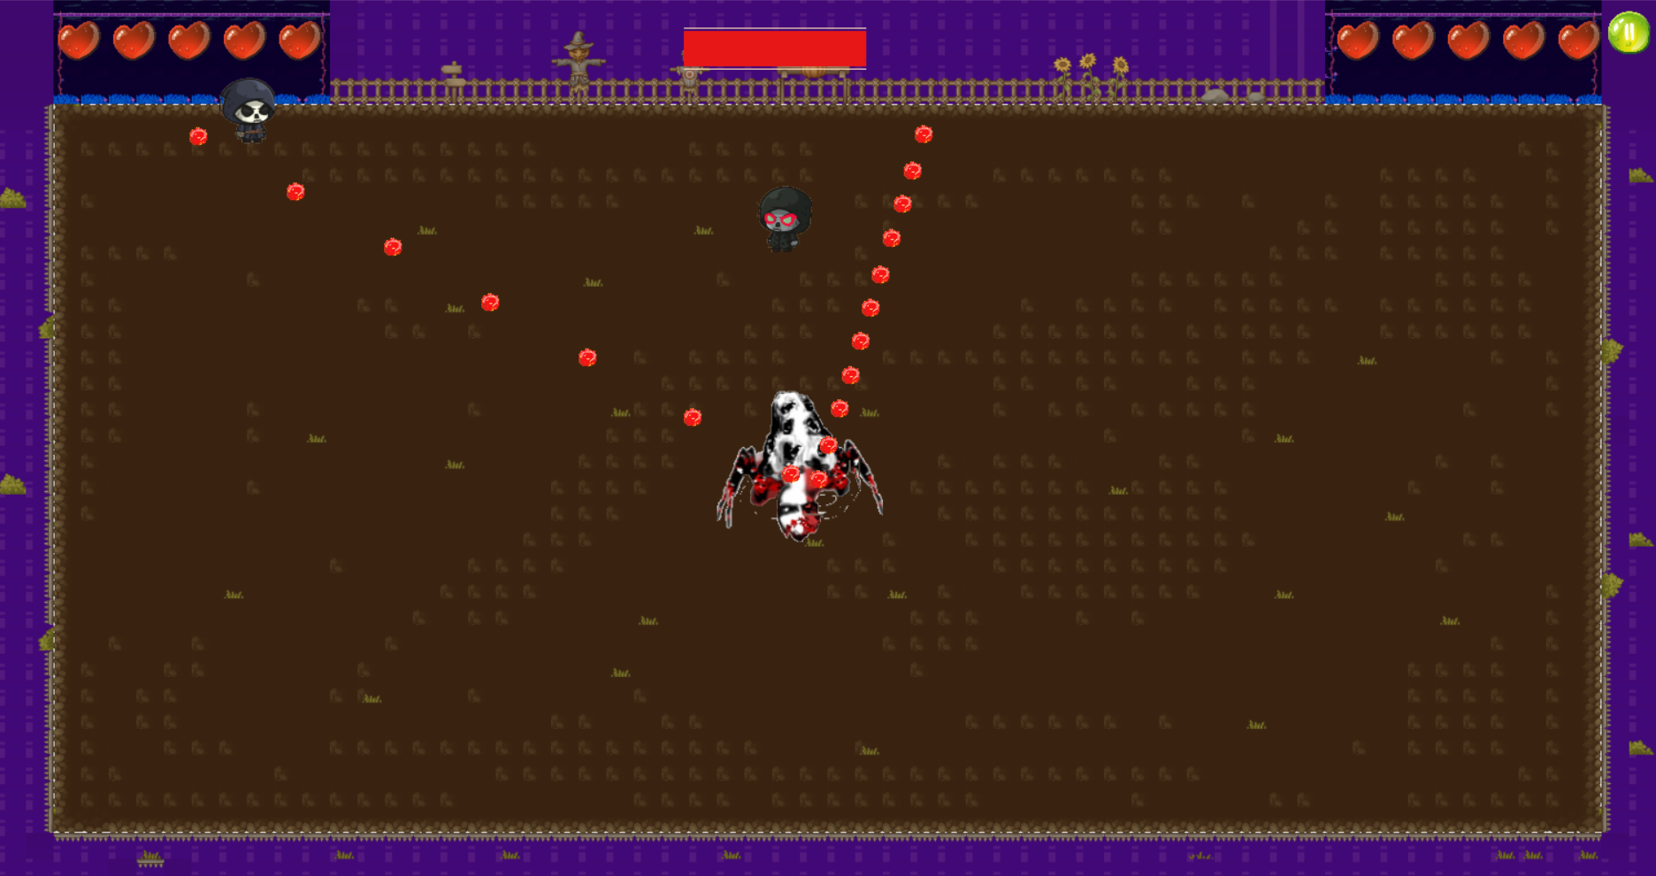
ROUND3 : HEAVEN OR HELL
- Kill both monster and other to victory
- Lost heart = die.

Slide 14
Difficulties
Search for assets online: There are many assets that you like but are not free
More new technologies need to study but its useful
First time, work with framework SDL2, work with Tiled to draw Map, work with Texture Packer Gui to create sprite sheet.

Slide 15
Develop
Develop multiple rounds with other rules and items
Continue story based on the revenge of the loser
Example: game 2 player battle with machine, kill other player 10 times to win, appears item to increase speed of bullets, ….

Slide 16
Thanks for listening!
Hope that we can receive
comments from you <3

